Slide 1
Promotion Analysis of Contoso Company
Bo Yang

Slide 2
Requirements for the project
Breakouts Of Net Quantity By Promotion Name & Year
Relationship Between The Average Sales Per Day And The Returns Quantity Ratio
Breakouts Of Average Sales Quantity Per Day By Promotion Name & Year
Promotion Details Table
Promotion Name And Date Info
Sales Quantity Info
Sales Amount And Profits Info
Filters
Date Info
Geography Info
Product Info
Drillthrough Of Product Details

Slide 3
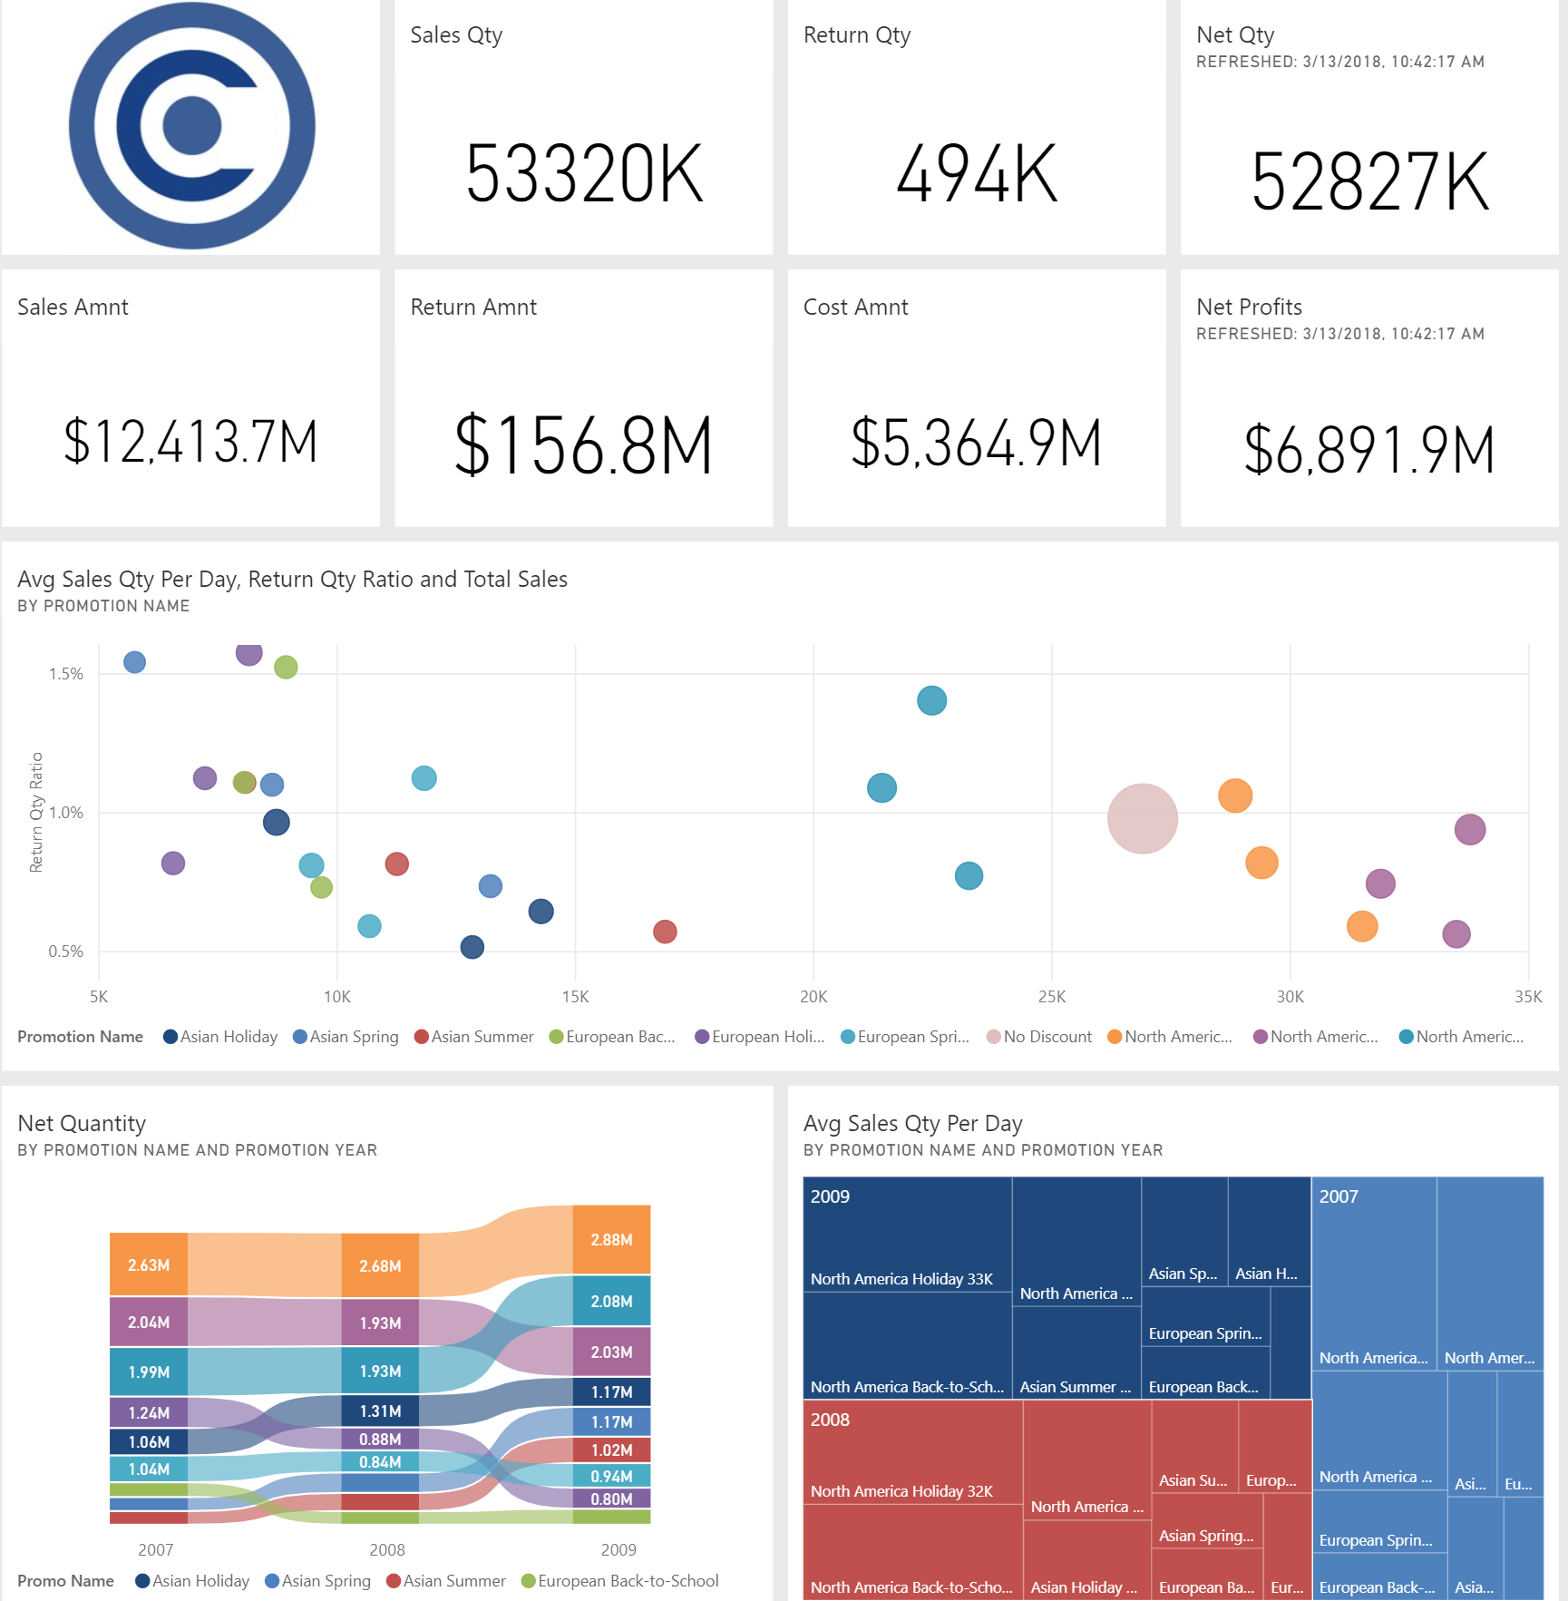
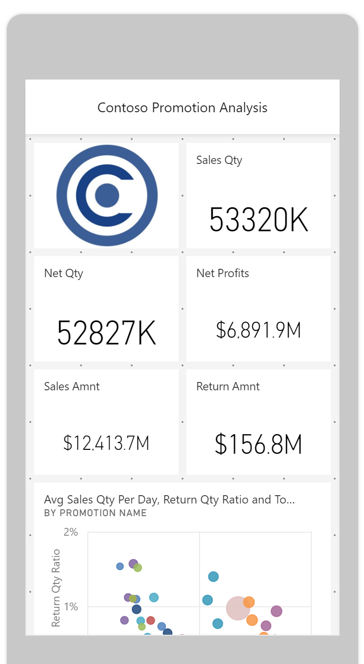
The dashboard created on PowerBI.com
Phone Layout
Desktop Layout

Slide 4
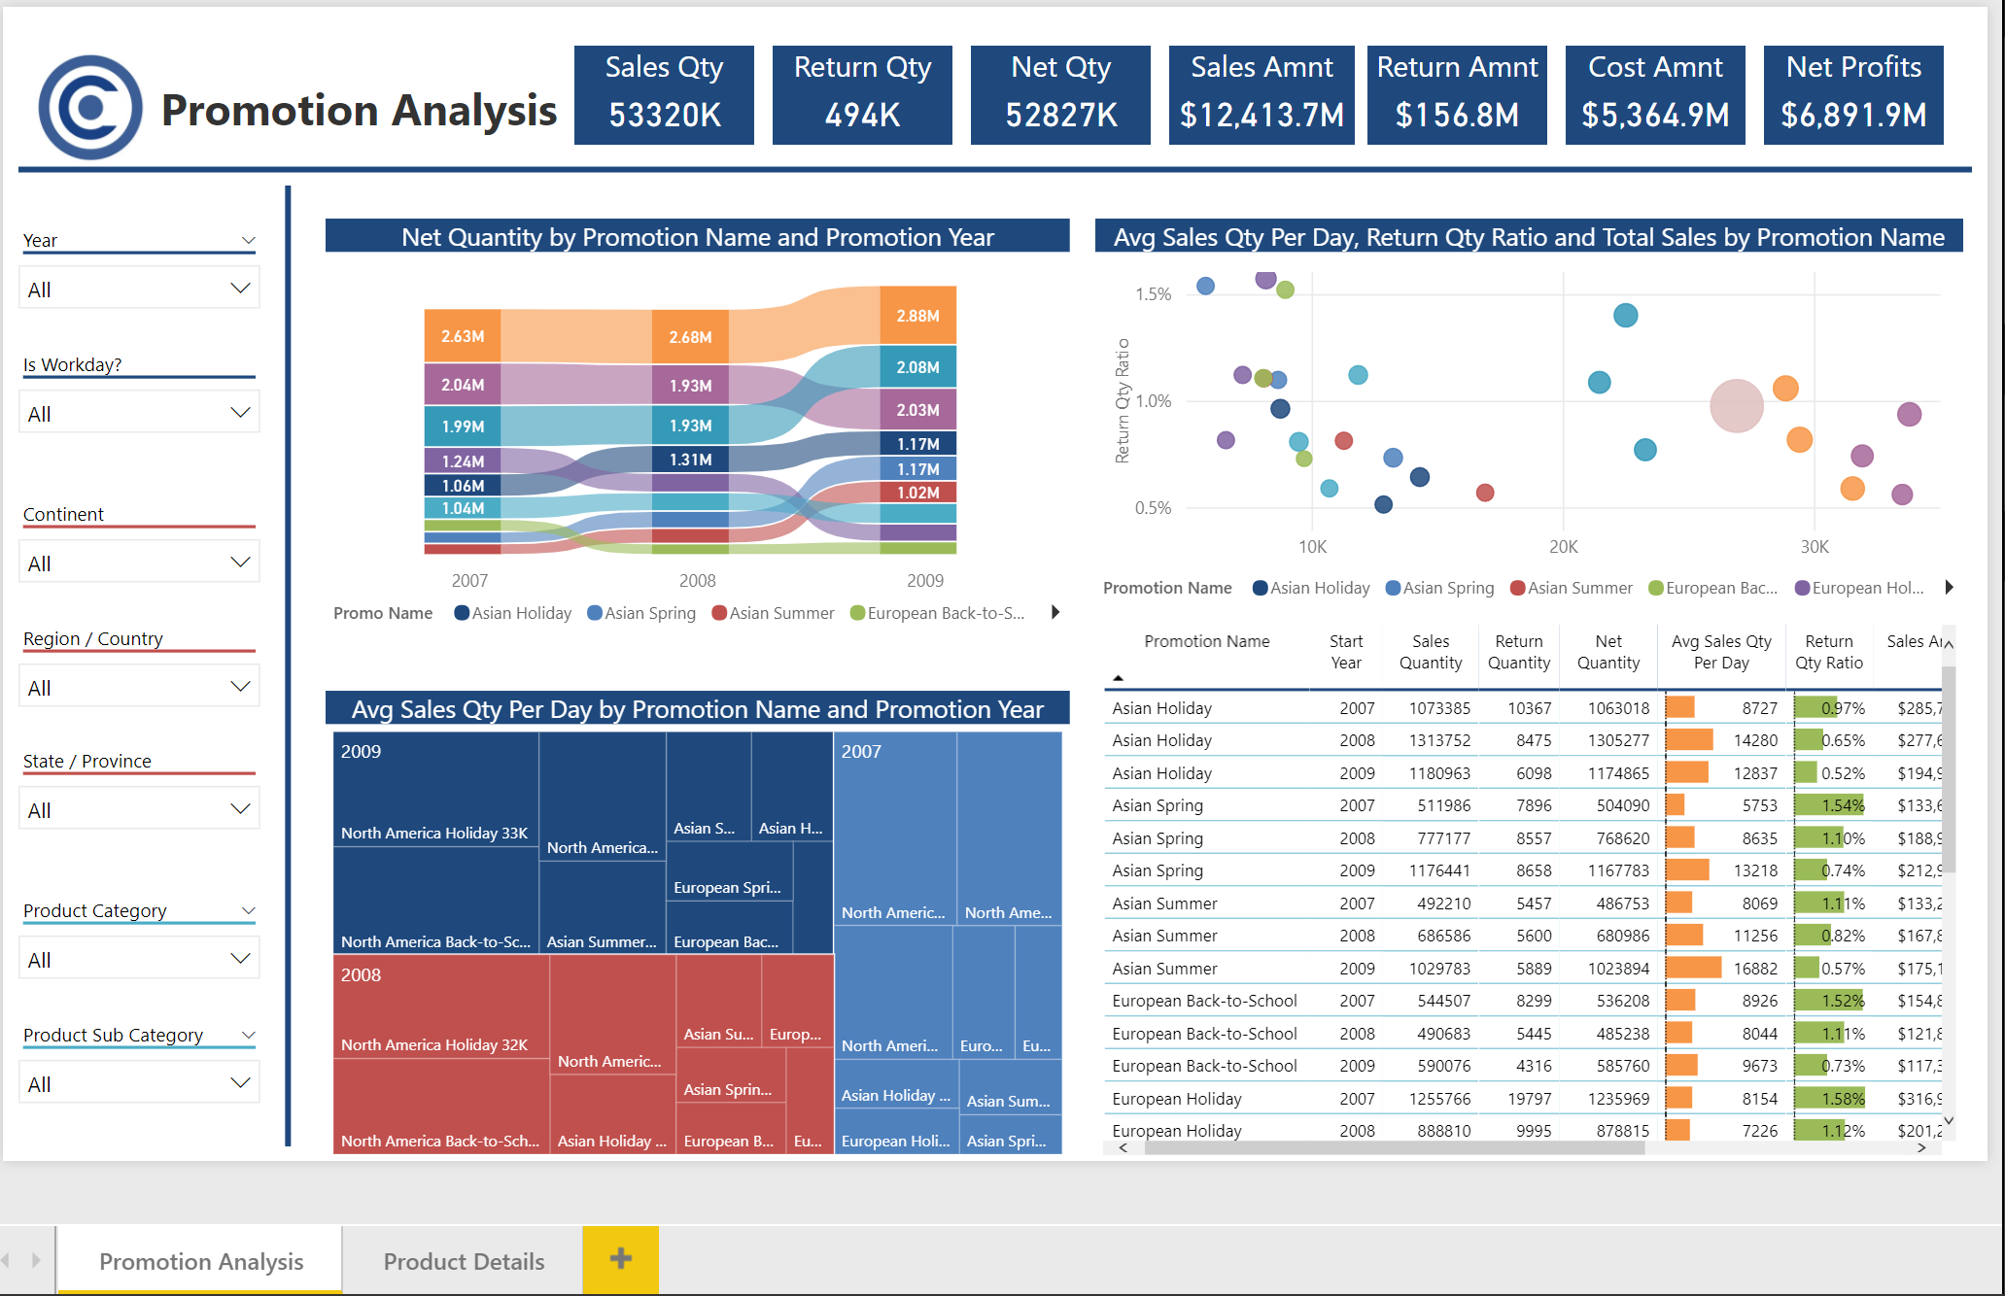
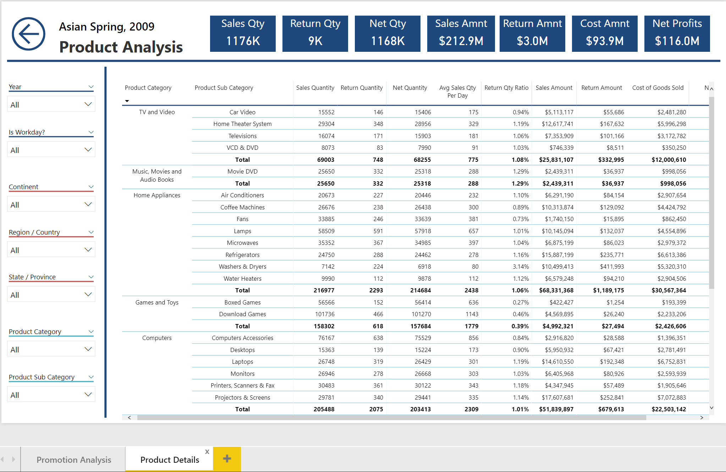
The Promotion Analysis Page created in Power BI Desktop
The Product Table Page created in Power BI Desktop

Slide 5
Questions
1. Which promotion had the highest average sales comparatively to lowest returns based on what you found in the visualizations?
North America Holiday 2009
2. Which promotion had the highest average sales overall?
North America Holiday
3. Which promotion had the lowest return ratio overall?
Asian Holiday
4. Were there any promotions that had a lower average sales quantity per day than the non-promotion period (AKA no discount promotion name)
All the promotions except for North America Holiday (2007-2009) and North America Back-to-school (2007-2009)

Slide 6
conclusions/recommendations
North America holiday promotion was the most successful promotional campaign during 2007-2009, which got the highest average sales per day and relatively low return quantity ratio.
Only North America promotions got more or similar average sales per day than no discount. All the other promotions had worse effect than no discount.
The company’s marketing department should continue to use the main marketing budget for implementing North America promotion campaigns, especially back-to-school promotion and holiday promotion. At the same time, pay close attention to learn the reason for return and improve it to further reduce the return quantity ratio.

